Slide 1
Linear Regression

Slide 2
Agenda
Introduction of ML (Machine Learning)
What is Linear Regression?
Its importance through use-cases. (Applications)
How it works? (Mathematical Working)
Evaluation Metrics
Lecture Take-Away

Slide 3
Machine learning is a field of artificial intelligence that allows systems to learn and improve from experience without being explicitly programmed.
Introduction of ML
“
”

Slide 4
Types of ML
Machine Learning
Supervised
Semi-Supervised
Unsupervised
Reinforcement Learning

Slide 5
Types of ML
Machine Learning
Supervised
Semi-Supervised
Unsupervised
Reinforcement Learning

Slide 6
Linear Regression
What is Linear Regression?

Slide 7
Linear Regression
Linear Regression is a statistical method used in data science and machine learning to model the relationship between a dependent variable (often called the target or response variable) and one or more independent variables (predictors or features).
How to find relationship?

Slide 8
Applications
Uses of Linear Regression.

Slide 9
Applications
Stock Price Prediction
Sales Forecasting
Real Estate Price Prediction
Player Performance Prediction
Energy Consumption Prediction

Slide 10
Mathematics
How linear regression works?

Slide 11

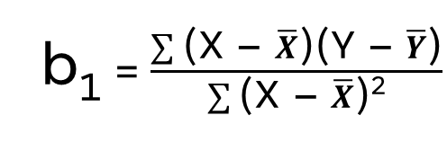
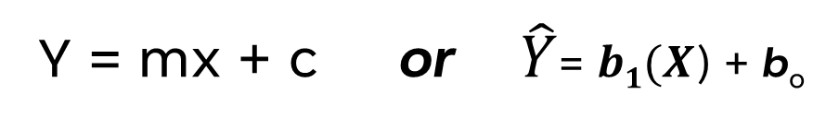
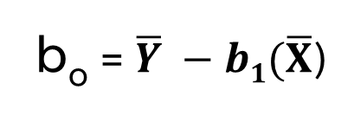

Mathematics Calculations:
Intercept
- Equation of Line:
Ads (X) | Sales (Y)
1 | 14
3 | 24
2 | 18
1 | 17
3 | 27
Y = mx + c or $\hat{Y}$= $b1(X$) + b_{o}
Slope:
“Unit of change in Y due to X”
- Formula for regression coefficient:
b₁ = $\frac{\sum{\text{(}\text{X}\text{ – }\overline{X}\text{)(}\text{Y}\text{ – }\overline{Y}\text{)}}}{\sum{\text{(}\text{X}\text{ – }\overline{X}\text{)}\text{2}}}$
- Formula for Intercept:
b_{o} = $\overline{Y} −b1(\overline{X}$)

Slide 12
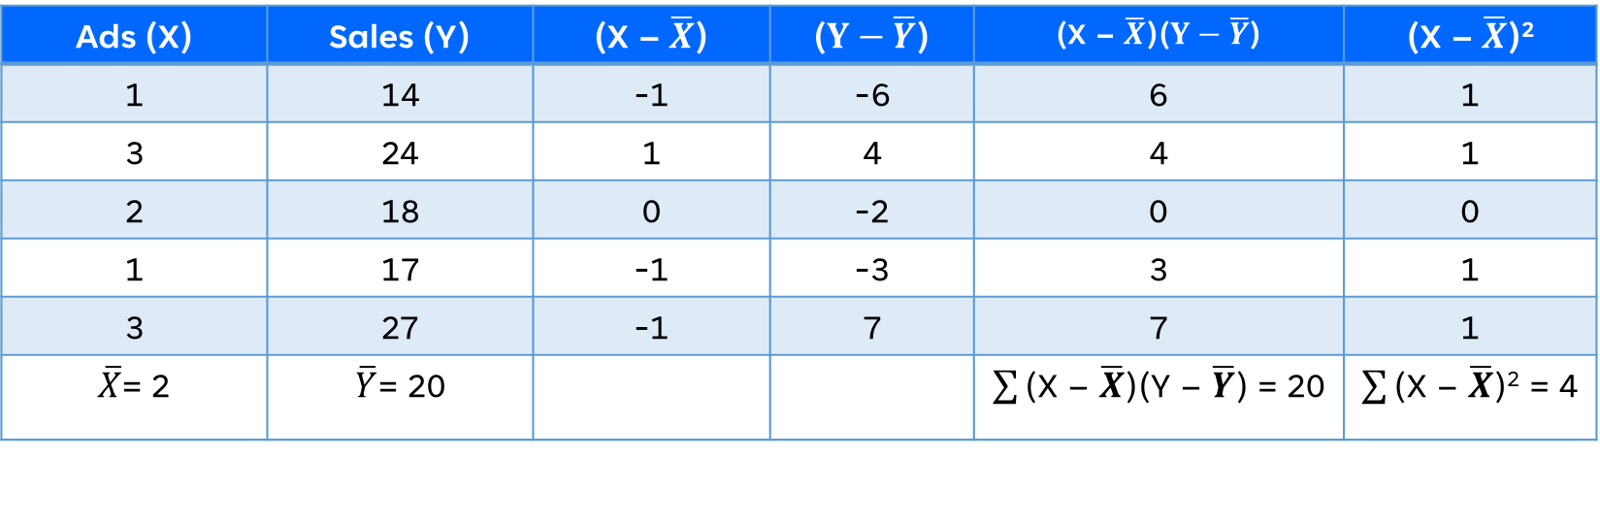
Mathematics Calculations:
Ads (X) | Sales (Y) | (X – $\overline{X}$) | ($Y−\overline{Y}$) | (X – $\overline{X}$)($Y−\overline{Y}$) | (X – $\overline{X}$)²
1 | 14 | -1 | -6 | 6 | 1
3 | 24 | 1 | 4 | 4 | 1
2 | 18 | 0 | -2 | 0 | 0
1 | 17 | -1 | -3 | 3 | 1
3 | 27 | -1 | 7 | 7 | 1
$\overline{X}$= 2 | $\overline{Y}$= 20 |  |  | $\sum{\text{(}\text{X}\text{ – }\overline{X}\text{)}\text{(}\text{Y}\text{ – }\overline{Y}\text{)}}$ = 20 | $\sum{\text{(}\text{X}\text{ – }\overline{X}\text{)}\text{2}}$ = 4

Slide 13
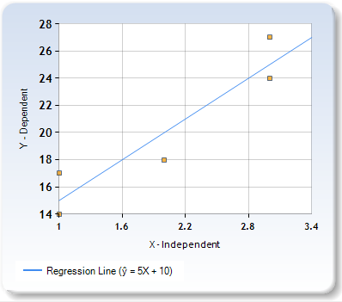
Regression Line (Chart)

Slide 14
Evaluation Metrics
To evaluate model performance.

Slide 15
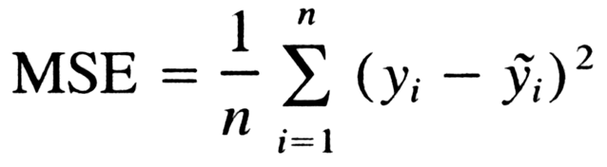
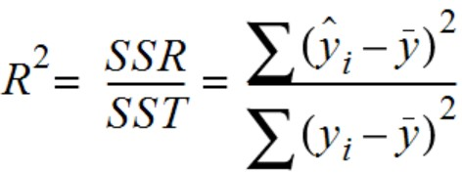
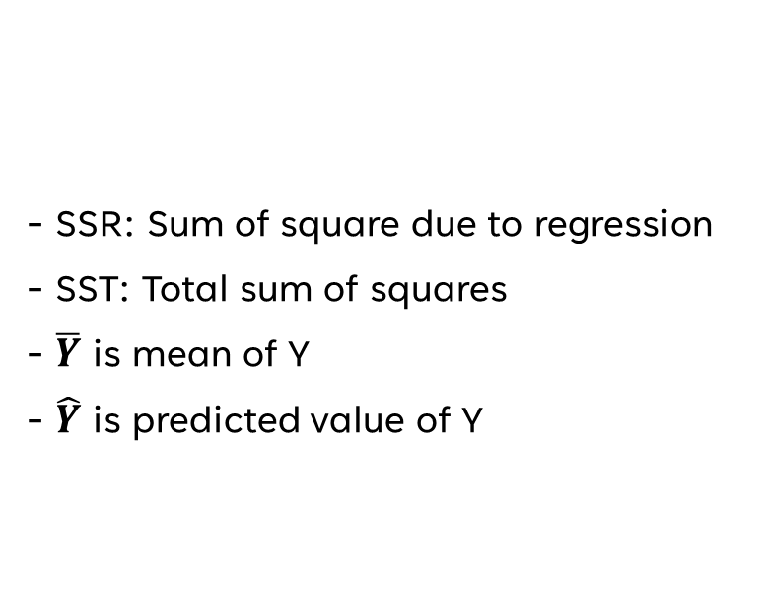

Evaluation Metrics
Mean squared error (MSE).
Coefficient of determination (R²):
- N is number of values
- Y_{i} is actual values
- $\hat{Y}$ is predicted value of Y
- SSR: Sum of square due to regression
- SST: Total sum of squares
- $\overline{Y}$ is mean of Y
- $\hat{Y}$ is predicted value of Y

Slide 16
Lecture Take-Away:
Linear Regression is an ______ algorithm:
A. Unsupervised B. Supervised C. Semi-Supervised D. None
What is the primary purpose of Linear Regression in data science?
To visualize data patterns B. To classify data into categories
C. To model relationships between variables D. To perform clustering analysis
Linear Regression can be used for:
A. Numeric Data B. Categorical Data C. Both D. None
In which domain is Linear Regression commonly used?
Healthcare B. Education C. Finance D. Environmental Science
What is M in Regression Equation, Y = mx + c?
A. Intercept B. Slope C. Error D. Constant

Slide 17
References
Lecture from Lecture 9: Linear Regression, UW Genome Sciences
Lecture from John S. Loucks
Lecture from Georgia Institute https://www2.isye.gatech.edu/~yxie77/isye2028/lecture11.pdf
MIT OpenCourseWare, Lecture 6: Regression Analysis

